Slide 1
Open House
2019-2020
Third Grade

Slide 2
No transportation changes over email or phone, unless it’s to keep your child at school in ASP – please send in a note
No toys or distractions
Water only and healthy snack
-Weekly Work and Behavior Reports go home most Fridays – Please discuss with child.
SIGN and RETURN on MONDAY!

Slide 3
7:15 - 8:15am Morning Work
8:15 – 10:15am ELA/Reading Block
10:15 – 11:20am Recess/Lunch Block
11:20 – 12:20pm Math Block
12:20 -1:00pm Science/S.S./Health Block
1:05 – 1:50pm Specials
1:55 – 2:15pm Pack up/Read Aloud/Dismissal
** SOME SCHEDULES VARY. SEE TEACHER FOR SPECIFIC SCHEDULES BY CLASS.**

Slide 4
* Please check backpack daily and make sure your child is organizing materials in order to ensure success.
* Behavior – All classes operate on a monetary system that supports our economic standards. Students can earn and lose money based on behavior. At the end of each nine weeks, we will use earned money to participate in a grade level school store.
* Following Directions and Listening *
We are:
BUILDING RESPONSIBILITY &
ACCOUNTABILITY ALL YEAR!
https://www.youtube.com/watch?v=lEWEB5SkUIc

Slide 5
Dismissal order this year -
*2:13 – Car riders, Walkers, ASP
*Next – 1st load buses
*After 1st load leaves – 2nd load and Daycare will be dismissed
*Reminder: NO email or texting transportation changes. All changes must be by note or called into the office.

Slide 6
Standard based grading –
1 – Does not Meet/Limited Progress
2 – Progressing toward meeting standard
3 – Meets Standard – CONSISTENTLY & INDEPENDENTLY
3+ - over and above
** Often a child has all 3s in 2nd grade and starts with all 2s in 3rd grade. Students will be working toward meeting some standards all year long so 2 is common.**

Slide 7
Homework nightly –
Kids are responsible for completing homework Monday-Thursday.
You can expect homework in Reading and Math almost every evening.
Student homework will be based on information already taught in class as a review.
Homework is NOT GRADED!
- RARELY, homework on FRIDAYS!

Slide 8
-Students should be reading chapter books on their lexile level.
-They should be understanding what they read.
(Read for Learning)
-Students should read 120 correct words per minute (CWPM) by 4th quarter – 90 CWPM for quarter 1.
-Build Reading Stamina
-Vocabulary building daily
-Reading groups/independent/with peers
-Fiction/Non-fiction

Slide 9
-Students must be able to write, write, write across all three genres of writing (Narrative, Opinion, Informational).
-They are writing to learn, using text evidence, and citing the text.
-They should take their writing through the writing process and self edit.
-We will learn CURSIVE this year!

Slide 10
-Practice math facts nightly.
-Fluency in math facts is half the battle of understanding math concepts.
-Timed tests during the week
-Interactive Notebooks/Journals – This is a resource that can be brought home.
-Hands-on
-Strategies/Algorithm
-Guided Math Groups
-Must be able to “explain how”

Slide 11
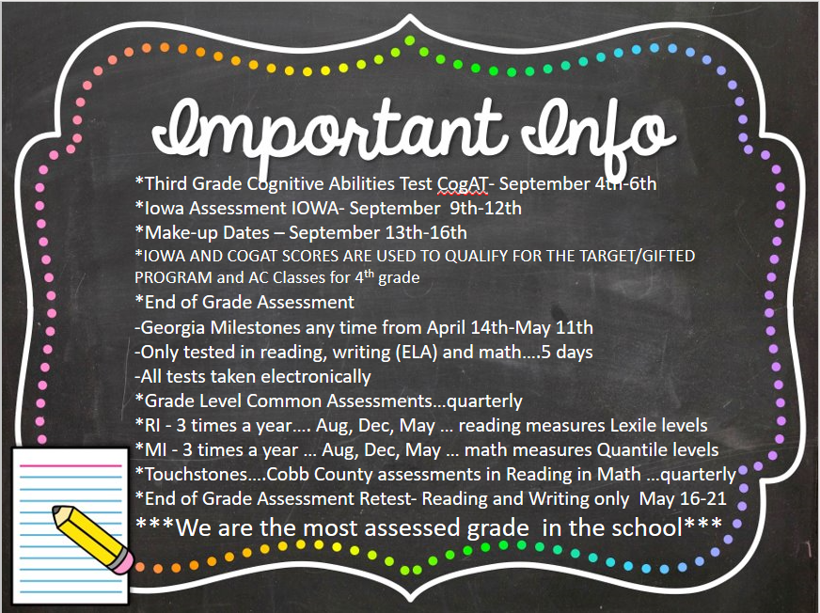

Slide 12
*CATO – Series of 3 in-school field trips
(Soil/fossils/habitats)
*Booth Museum– OFF campus field trip (Cartersville) – Native Americans
*Hernando DeSoto, Pilgrims, and Grammar shows
*GA Power, Wellstar, and Cobb Watershed Program and Ecosystems
*Diamond Del – possible field trip
Wear class shirt!!

Slide 13
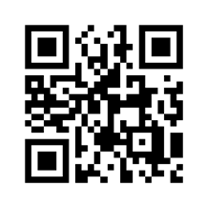
-Keep a close eye on our
Grade level website for news, dates to remember, and important info about our grade level!
-Make sure you are on Remind.

Slide 14
By email
- Email student’s classroom teacher
*Checked often throughout day
- Also texting through
Remind

Slide 15
THANKS FOR COMING!! WE LOOK FORWARD TO A WONDERFUL YEAR!

